Slide 1
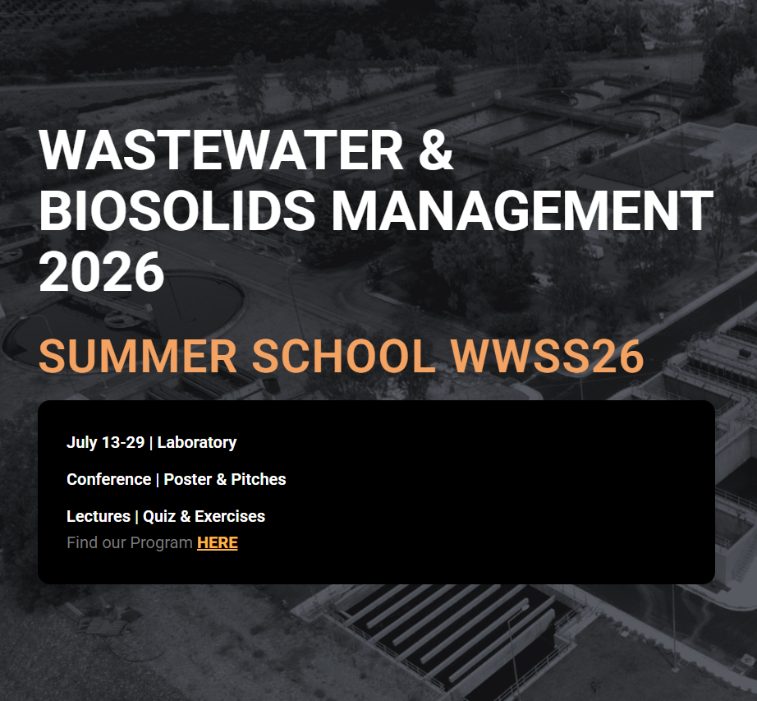


e-distance Learning
WWSS26
The International Summer School on “Wastewater and Biosolids Management” (WWSS) is a distinguished educational initiative established in 2015 that brings together academics, researchers, professionals, and stakeholders from around the world who are involved in water, wastewater, and environmental management sectors.

Slide 2


Experience the full WWSS26 program from anywhere in the world!
Synchronous (Live) Sessions: Interact with instructors, participate in discussions, and join live workshop.
Asynchronous Materials: Watch lectures, complete assignments, and explore virtual lab exercises at your convenience.
Master’s Students
PhD Candidates
Early-Career Researchers
Engineers & Environmental Scientists
Wastewater & Biosolids Professionals
Public Sector Representatives & Water Utility Personnel
Consultants & Industry Practitioners
Stakeholders in Water, Waste & Environmental Sectors
Who Should Attend?

Slide 3


Topics
Linking Climate Change Impacts and Wastewater Treatment Strategies
Catalysis in Wastewater Treatment Processes and Innovations
Sustainable Agricultural Practices through Wastewater Treatment and Reuse
Adsorption Mechanisms and Adsorptive Materials in Wastewater Management
Microbiology, Public Health, and Wastewater Management
Energy Valorization of Sewage Sludge and Biosolids
Circular Approaches in Wastewater Management

Slide 4
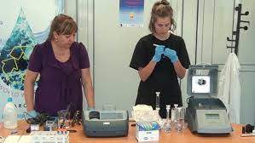

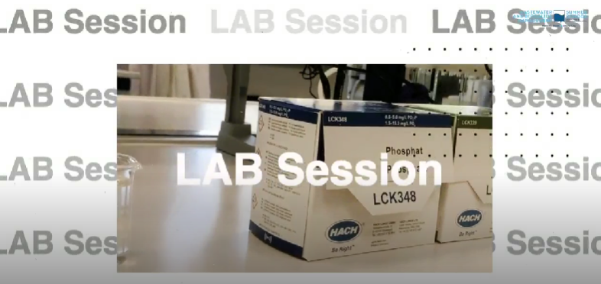
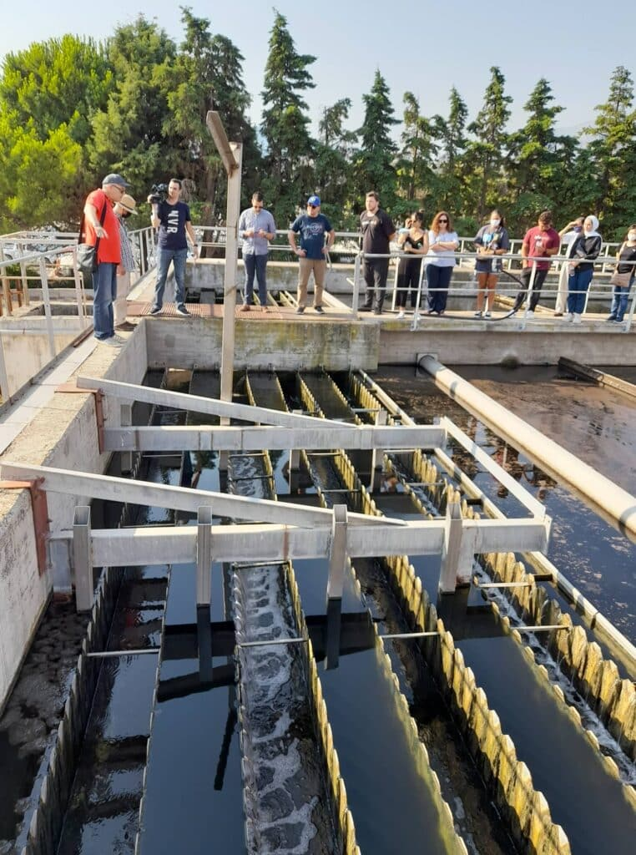

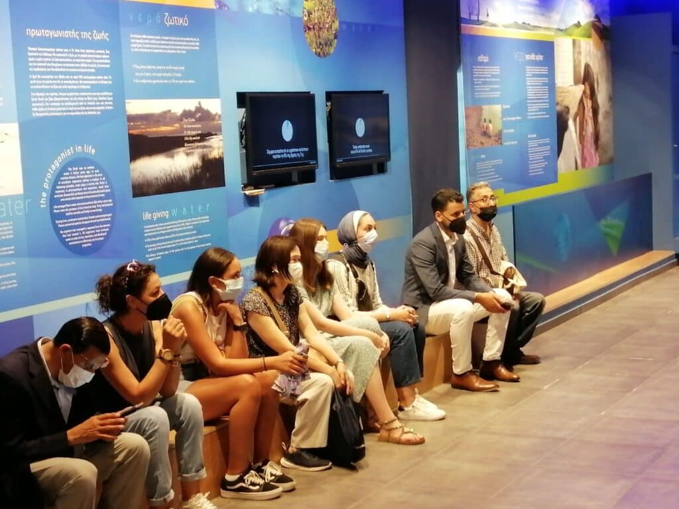
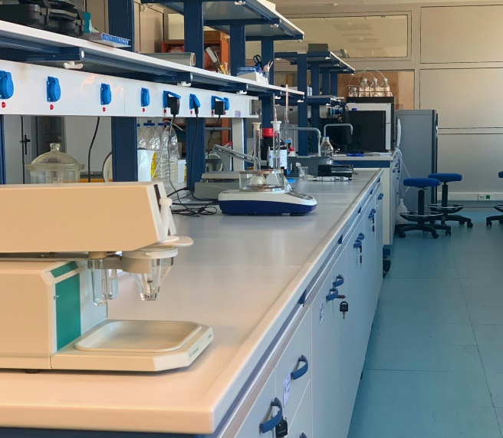

Hands-on Wastewater Analysis: Laboratory and Video Exercises
E-learning distance education
Laboratory exercise
Technical e-Tour
International Summer School

Slide 5
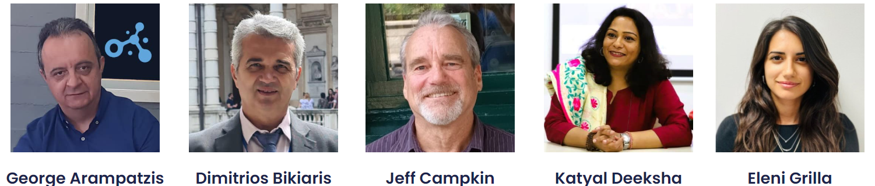
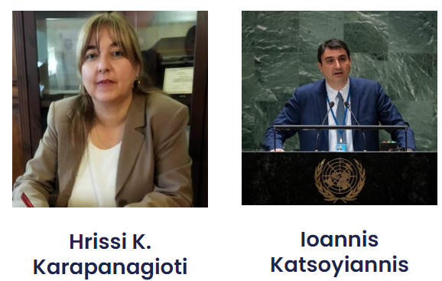

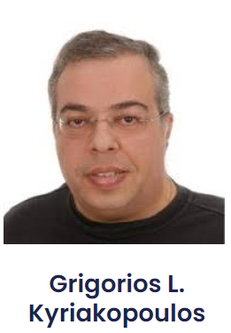
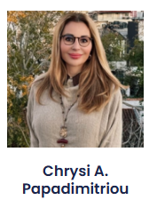

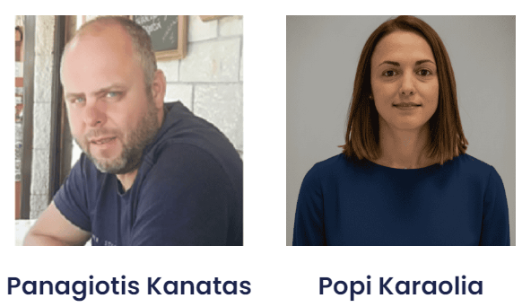
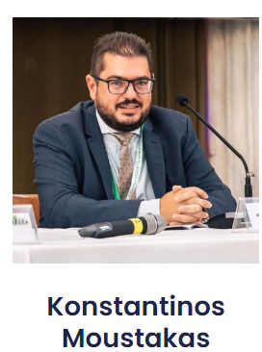
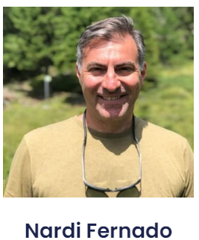
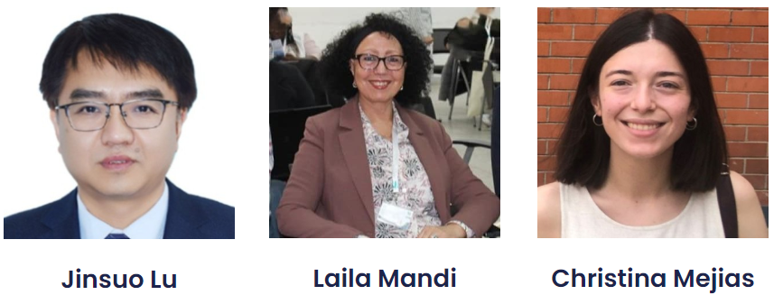
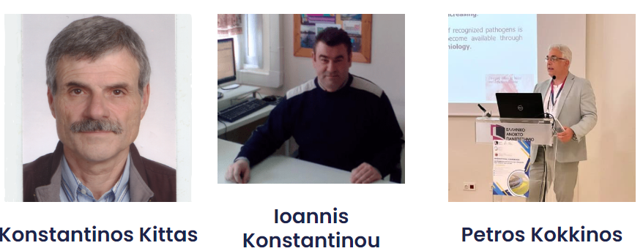
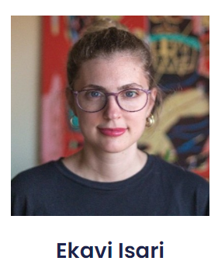
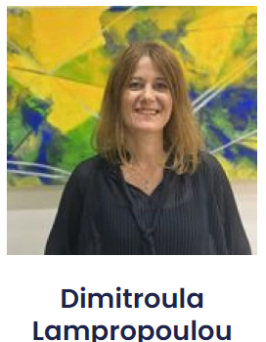
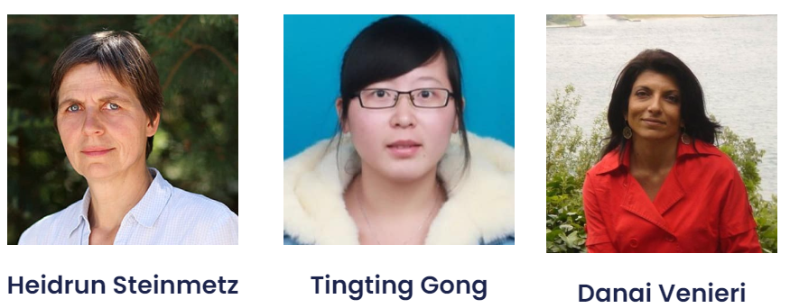
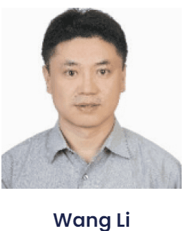
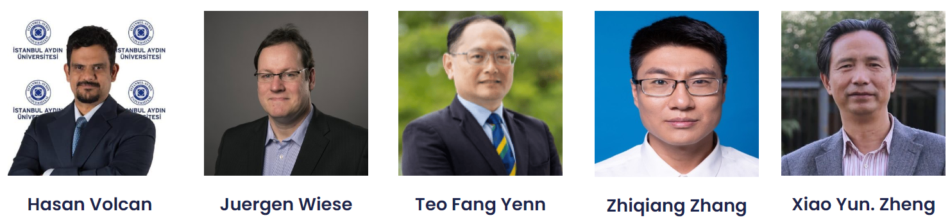
KEYNOTE
SPEAKERS
Professors and experts from all over the world

Slide 6



e-Poster and Pitch Session
The Summer School invites participants to present their work through a combined Poster & Pitch format, aiming to highlight key research outcomes while fostering concise and effective scientific communication.
The best e-poster will receive a monetary prize of 300 CHF, sponsored by the journal Environments (MDPI).
Participants will have the opportunity to submit their research work for publication in the Special Issue of the Summer School in the journal Environments.

Slide 7

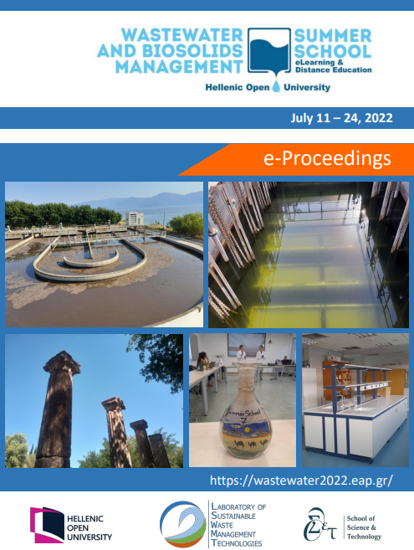
e-Proceedings
Accepted extended abstracts of the e-posters will be published in the official e-proceedings of WWSS26.

Slide 8

Register Now
Join WWSS26:
150 € for Students
200 € for Professionals & All Other Categories
Registration and fee payment will be completed exclusively through the Centre for Continuing Education and Lifelong Learning (CCE/KEDIVIM) online platform.
Certificate of Attendance:
2 ECTS credits

Slide 9


Scan for more details about WWSS26

